Slide 1
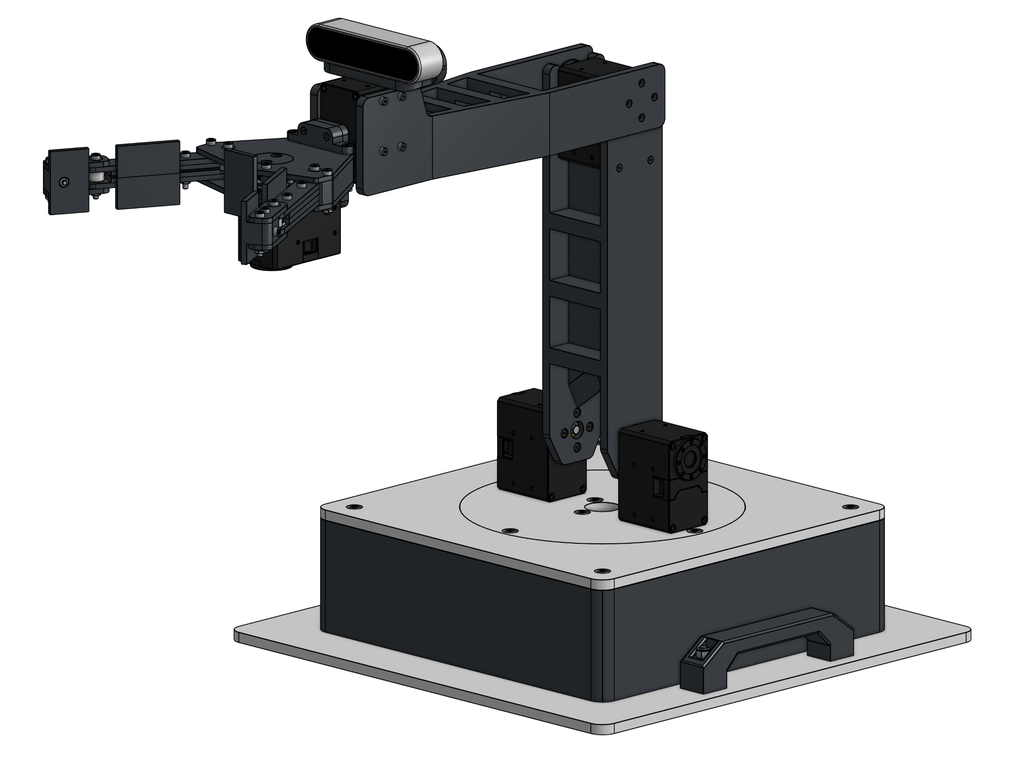
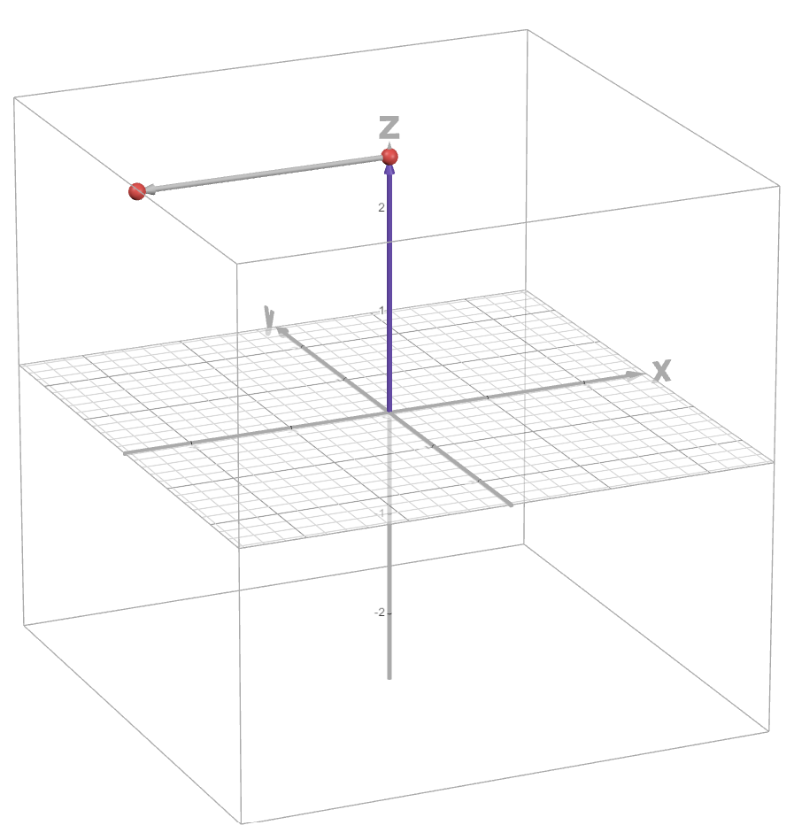
The Trigonometric Approach to Forward Kinematics
By Joseph Ruhan

Slide 2
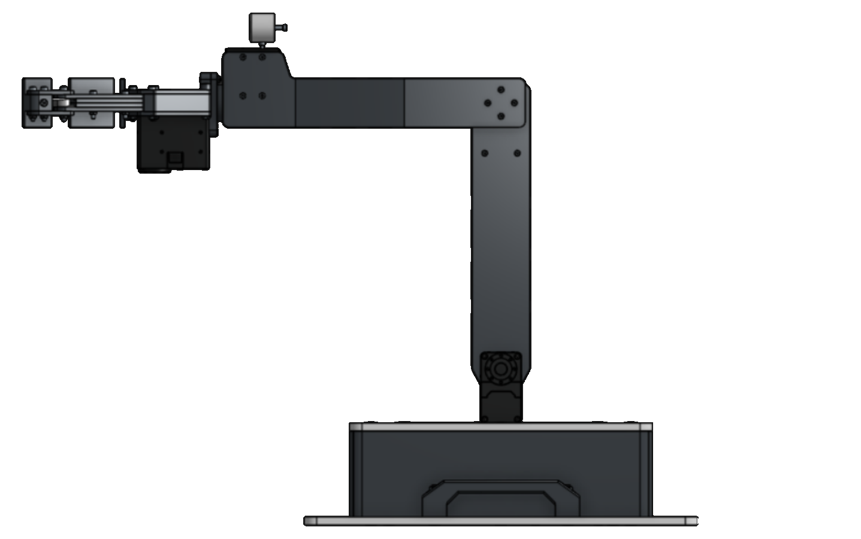
The arm can be described mathematically by defining its joints and links
L₂
Where
L₁=250mm
L₂=250mm
These are always known because they are a constant
L₁

Slide 3
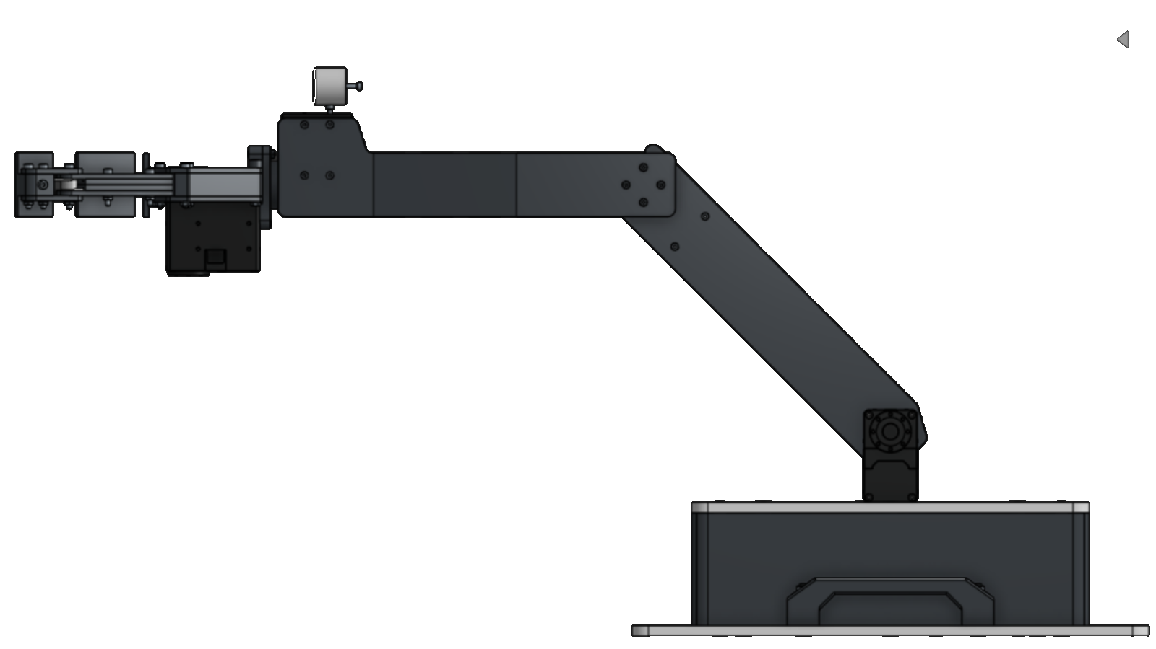
In this example
θ₁=45°
θ₂=45°
θ₁ is measured relative to a vertical projection above the shoulder motors
θ₂ is measured relative to the straight-line extension of the upper arm segment
θ₂
θ₁
These angles are variable.
However, because the encoder measures the rotation of the actuator, the angles are always known

Slide 4
The arm can therefore be represented as such:
= a joint
L₁=250mm
L₂=250mm
θ₁=45°
θ₂=45°
θ₂
L₂
θ₁
L₁

Slide 5
The arm can therefore be represented as such:
= a joint
L₁=250mm
L₂=250mm
θ₁=45°
θ₂=45°
(X, Y)
θ₂
Y
θ₁
The location of the end effector is the unknown variable
(0, 0)
X

Slide 6
The arm can therefore be represented as such:
= a joint
ΔX₁
L₁=250mm
L₂=250mm
θ₁=45°
θ₂=45°
(X, Y)
θ₂
ΔX₂
ΔY₁
θ₁
The position of the end effector will be a sum of the vertical and horizontal displacement of each joint

Slide 7
The arm can therefore be represented as such:
= a joint
L₁=250mm
L₂=250mm
θ₁=45°
θ₂=45°
θ₂
ΔX₁
(X, Y)
ΔX₂
ΔY₁
The displacement can be represented by triangles
θ₁
(0, 0)

Slide 8
Each link has its own triangle
L₁ is the hypotenuse of the upper arm triangle (ΔX₁, ΔY₁)
To use sin and cos, we need the angle between the link and vertical
Upper arm: θ₁ is already measured from vertical, so we use θ₁
ΔX₁
(X, Y)
ΔY₁
θ₁
L₁

Slide 9
The forearm uses θ₁ + θ₂
L₂ is the hypotenuse of the forearm triangle (ΔX₂, ΔY₂)
θ₂ is measured from the upper arm’s direction, not from vertical
From vertical, the forearm has turned θ₁ + θ₂
Here: 45° + 45° = 90°, so the forearm is horizontal
Check: if θ₂ = 0° the arm is straight, so the angle is just θ₁
vertical
upper arm’s direction
θ₁
(X, Y)
L₂
θ₂
θ₁

Slide 10
To calculate the position of the end point:
L₁=250mm
L₂=250mm
θ₁=45°
θ₂=45°
In this example, L₁ is
the hypotenuse of a
triangle.
Using sin(θ₁):
sin(θ₁) = ΔX₁/L₁
L₁sin(θ₁) = ΔX₁
250*(√2/2) = ΔX₁
ΔX₁ = 176.777mm
θ₂
ΔX₁
(X, Y)
ΔX₂
ΔY₁
L₁
θ₁
(0, 0)

Slide 11
To calculate the position of the end point:
ΔX₁ = 176.777mm
For cos(θ₁):
cos(θ₁) = ΔY₁/L₁
L₁cos(θ₁) = ΔY₁
250*(√2/2) = ΔY₁
ΔY₁ = 176.777mm
The forearm angle is θ₁+θ₂ = 90°
ΔX₂ = L₂sin(θ₁+θ₂)
250*sin(90°) = ΔX₂
ΔX₂ = 250mm
ΔY₂ = L₂cos(θ₁+θ₂)
250*cos(90°) = ΔY₂
ΔY₂ = 0mm
θ₂
ΔX₁
(X, Y)
ΔX₂
ΔY₁
θ₁
(0, 0)

Slide 12
To calculate the position of the end point:
ΔX₁ = 176.777mm
ΔY₁ = 176.777mm
ΔX₂ = 250mm
ΔY₂ = 0mm
θ₂
ΔX₁
(X, Y)
ΔX₂
(X,Y) = (ΔX₁+ΔX₂,ΔY₁+ ΔY₂)
(X,Y) = (426.777, 176.777)
ΔY₁
θ₁
(0, 0)

Slide 13
Completed Variables
θ₂
θ₁
(426.777, 176.777)
L₁=250mm
L₂=250mm
θ₁=45°
θ₂=45°
(X,Y) = (426.777, 176.777)

Slide 14
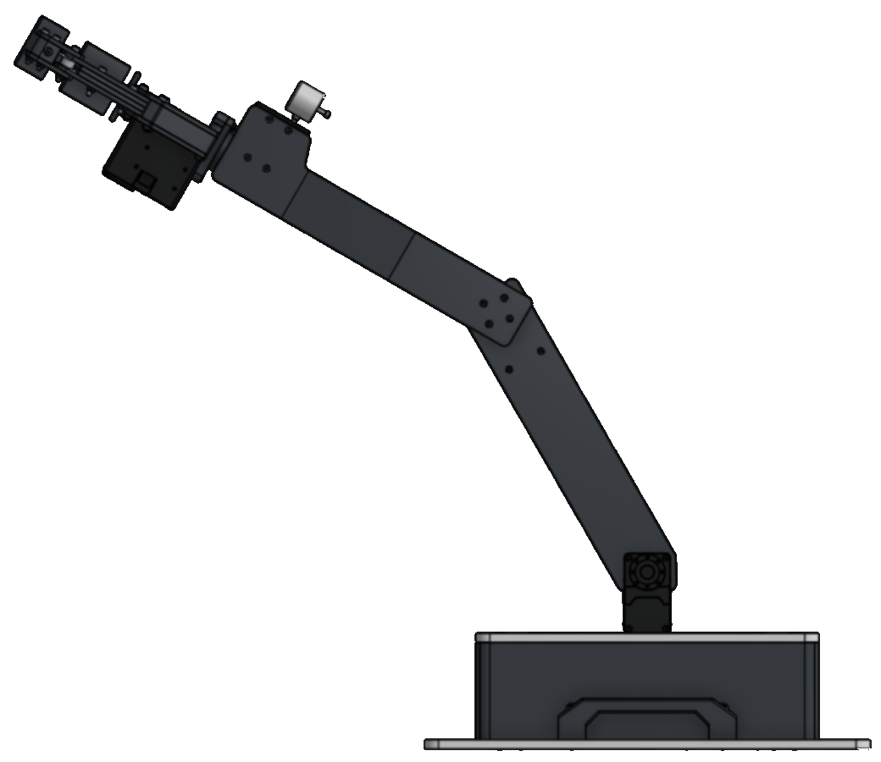
Try It Yourself:
L₁=250mm
L₂=250mm
θ₁=30°
θ₂=30°
(X,Y) = (?,?)
θ₂
(X,Y)
θ₁

Slide 15
Try It Yourself:
L₁=250mm
L₂=250mm
θ₁=30°
θ₂=30°
(X,Y) = (?,?)
θ₂
(X,Y)
Solution:
(X,Y) = (341.506, 341.506)
θ₁

Slide 16
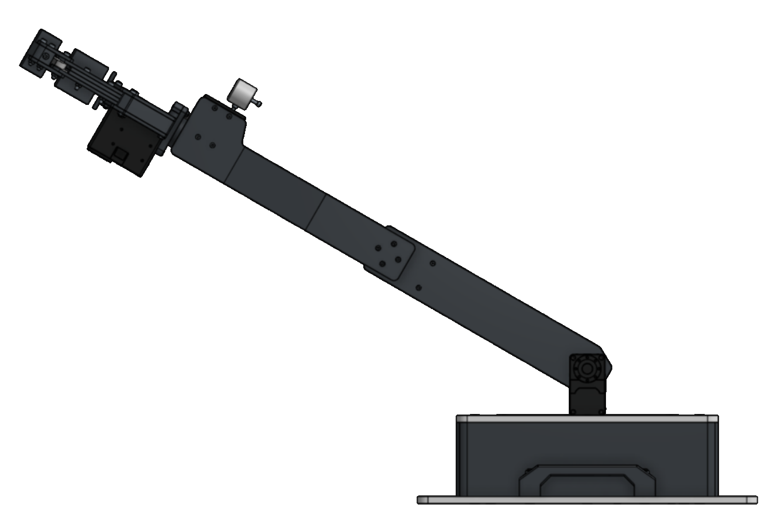
Try It Yourself 2:
L₁=250mm
L₂=250mm
θ₁=60°
θ₂=0°
(X,Y) = (?,?)
(X,Y)
θ₁

Slide 17
Try It Yourself 2:
L₁=250mm
L₂=250mm
θ₁=60°
θ₂=0°
(X,Y) = (?,?)
Solution:
(X,Y) = (433.013, 250)
(X,Y)
θ₁

Slide 18
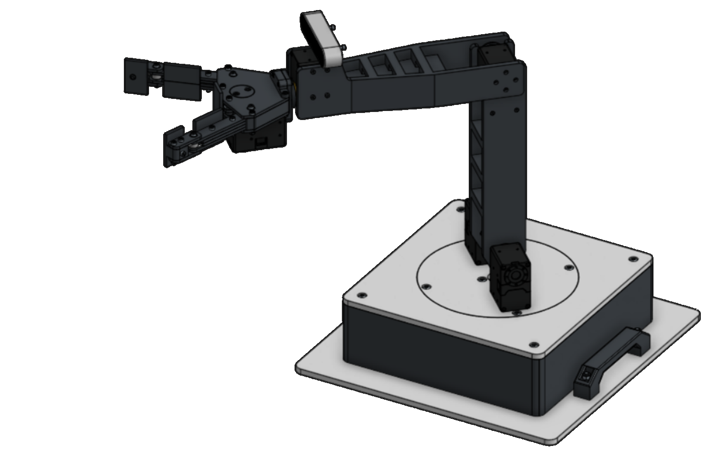
Forward Kinematics With Base Rotation

Slide 19
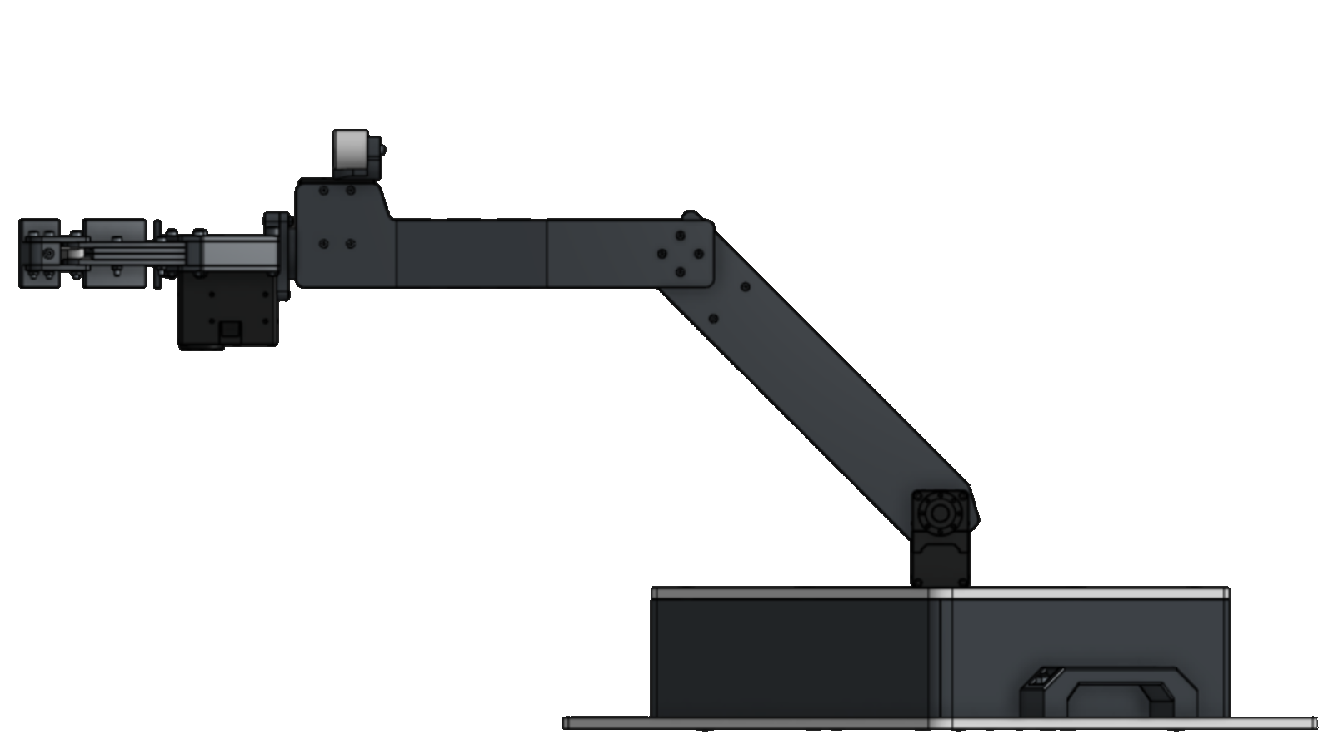
The arm’s forward kinematics with base rotation is dependent on rotation around the center point of the base
(X,Y)
R
Where
R = Horizontal distance from end effector to base center point

Slide 20
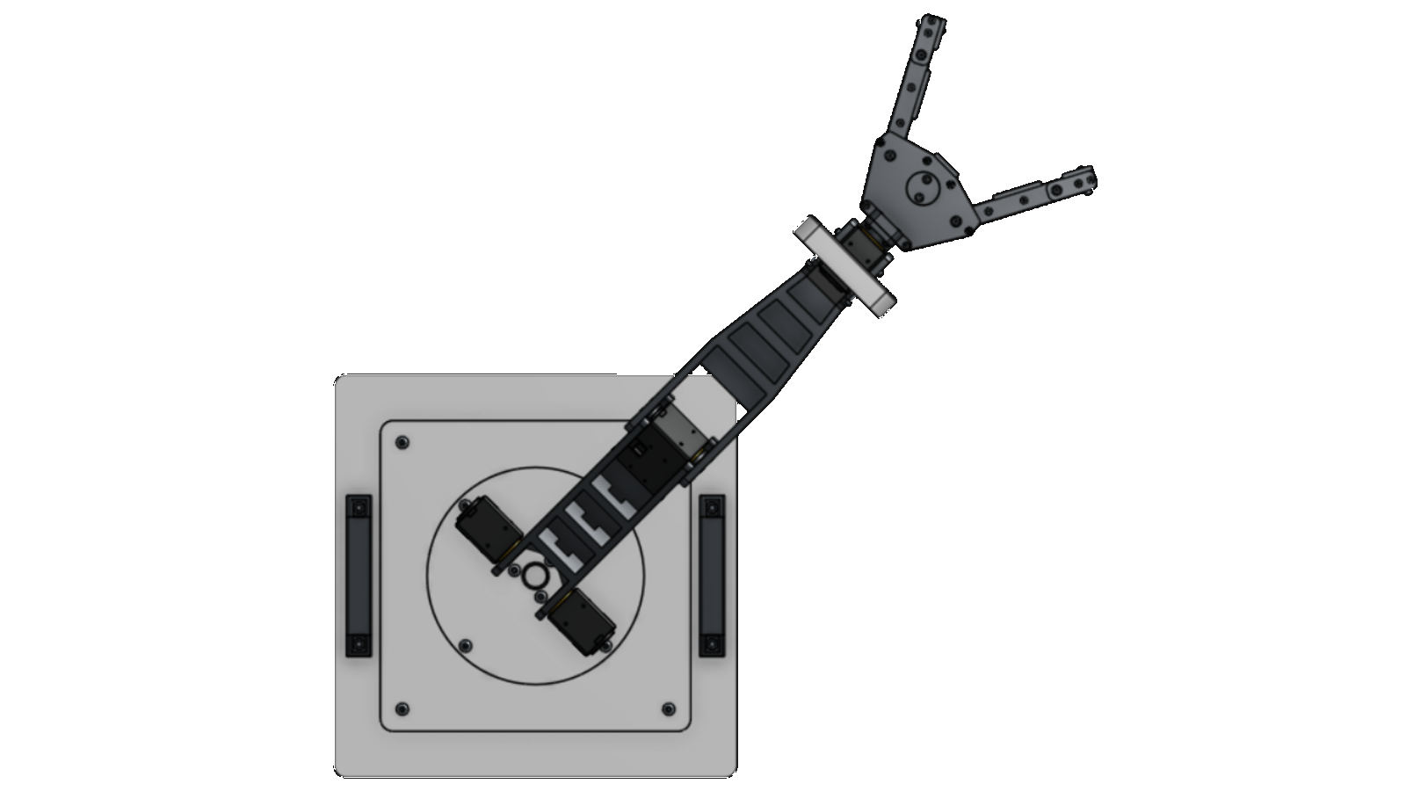
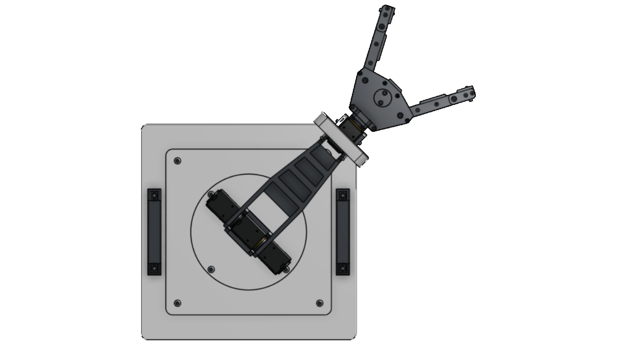
R is variable because the end effector can move away or closer to the base center point, horizontally
R₂
R₁
R₁ < R₂

Slide 21
R forms a circle around the center of the base when rotated
R

Slide 22
θ₃ is known because we can measure the rotation of the base actuator with its encoder
θ₃
R

Slide 23
So if R is calculated, the position of the end effector in 3D space can be determined
(X,Z)
X
θ₃
R
Z

Slide 24
The problem can be represented as a circle with a radius
To find (X,Z)
1. Find R
2. Calculate the
location of R on the
circle
(X,Z)
X
θ₃
R
Z

Slide 25
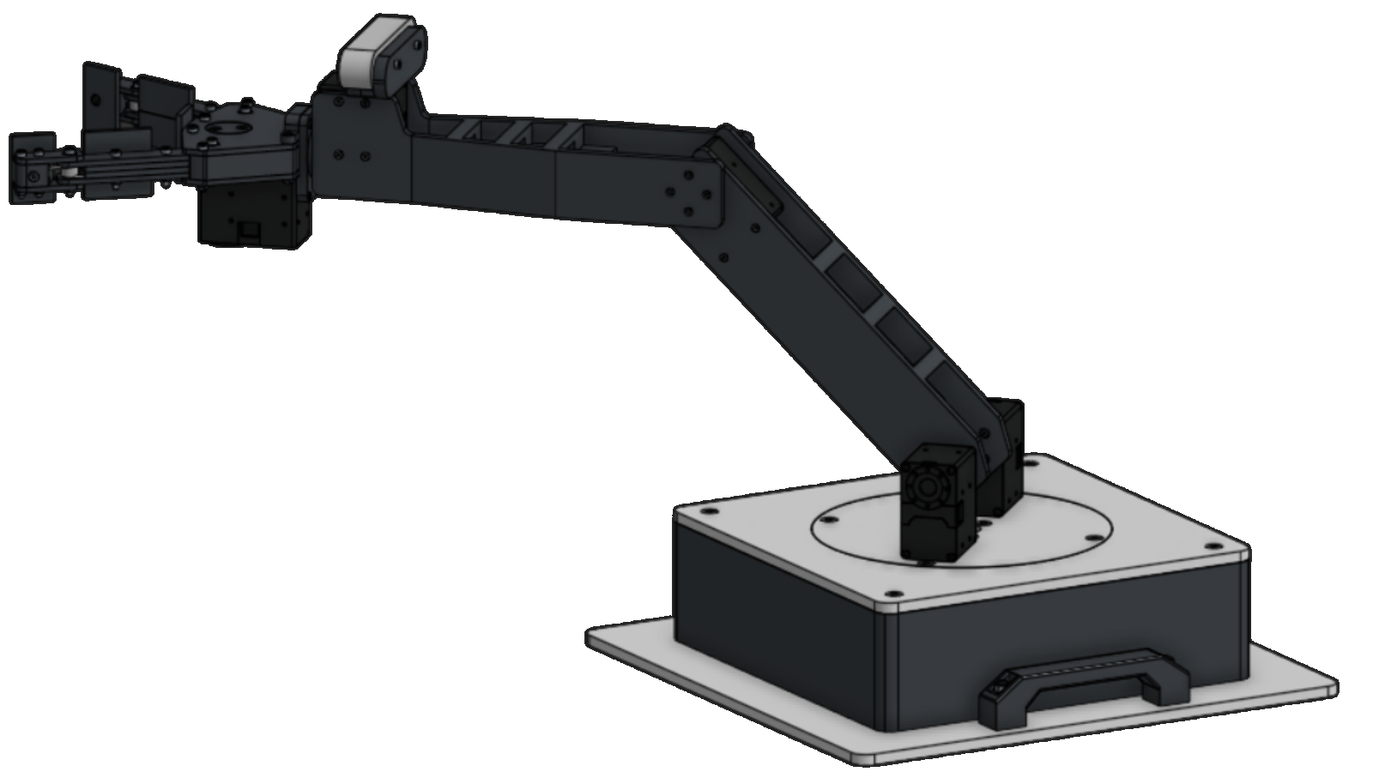
Example Problem
Y
Z
L₁=250mm
L₂=250mm
θ₁=45°
θ₂=45°
θ₃=45°
(X,Y,Z) = (?,?,?)
θ₃
X

Slide 26
This problem can be split into two 2D problems
Solving for R:
along the arm's
own XY plane
Solving for X and Z:
Along the XZ plane

Slide 27
The problem can be solved along these two planes
X
θ₂
θ₃
R
θ₁
Z
R

Slide 28
R will be equal to the X value we calculated when analyzing this position in 2D
(X, Y)
θ₂
For this problem
(L₁=250mm, L₂=250mm, θ₁=45°, θ₂=45°)
We solved it already and
determined (X,Y) to equal
(426.777, 176.777)
In this frame, R=x
Therefore, R=426.78mm
and Y=176.78mm
θ₁
R

Slide 29
Along the XZ Plane
R= 426.78mm
θ₃= 45°
Z = Rsin(θ₃)
X = Rcos(θ₃)
Z = 301.78mm
X = 301.78mm
Z
X
θ₃
R
X
θ₃
R
Z

Slide 30
Example Problem: Solution
L₁=250mm
L₂=250mm
θ₁=45°
θ₂=45°
θ₃=45°
Y
Z
X = 301.78mm
Y=176.78mm
Z = 301.78mm
X

Slide 31
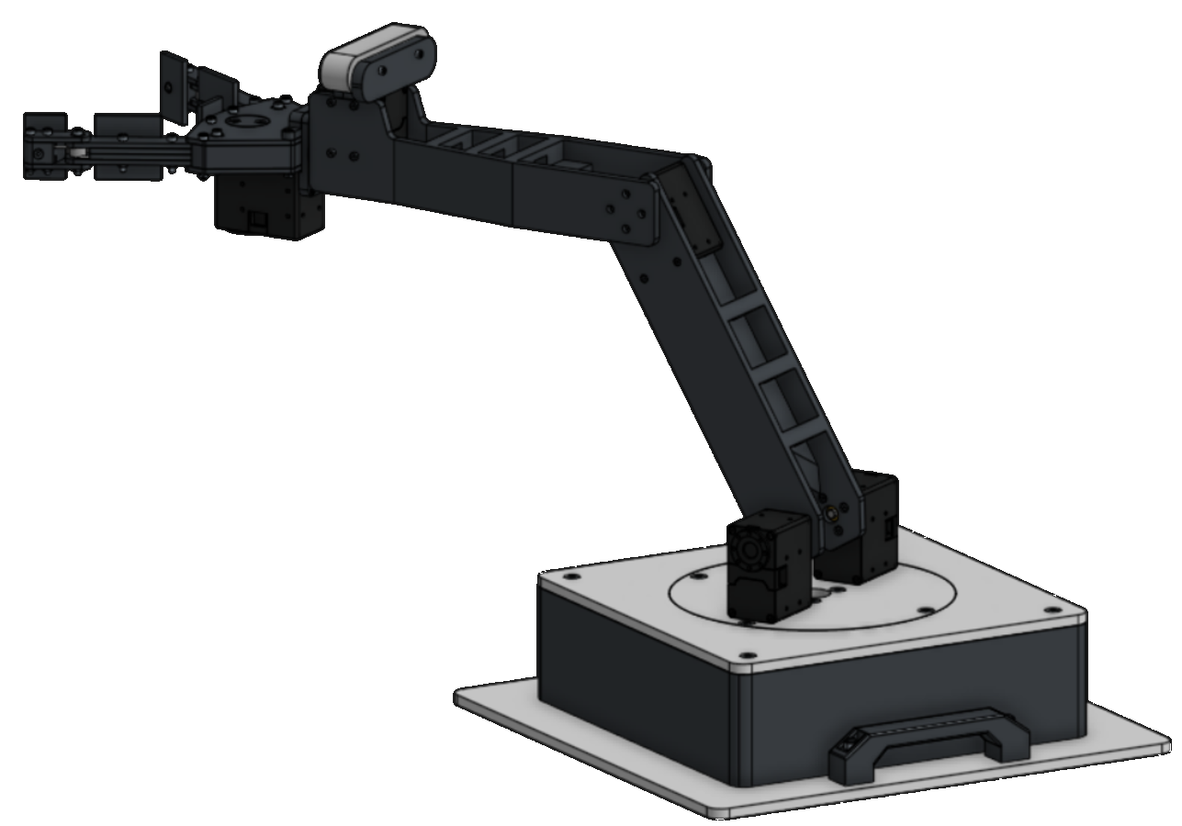
Practice Problem 1
L₁=250mm
L₂=250mm
θ₁=30°
θ₂=30°
θ₃=60°
(X,Y,Z) = (?,?,?)
Y
Z
θ₃
X

Slide 32
Practice Problem 1
L₁=250mm
L₂=250mm
θ₁=30°
θ₂=30°
θ₃=60°
(X,Y,Z) = (?,?,?)
Y
Z
Solution:
(X,Y,Z) = (170.75,341.51,295.75)
Click To Reveal
θ₃
X

Slide 33
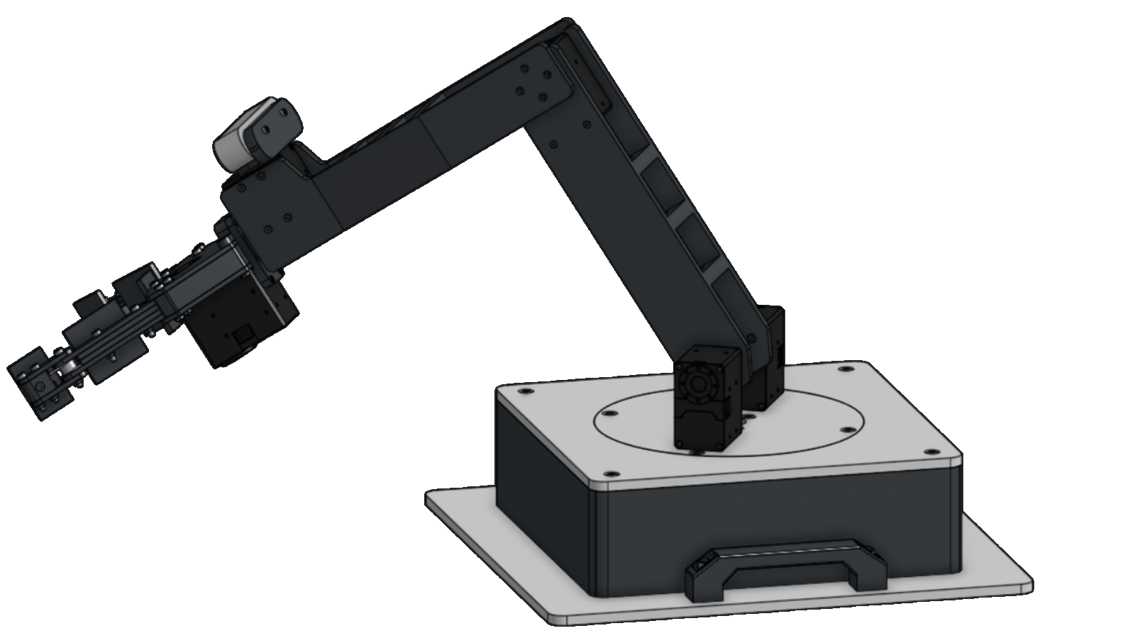
Practice Problem 2
L₁=250mm
L₂=250mm
θ₁=30°
θ₂=90°
θ₃=30°
(X,Y,Z) = (?,?,?)
Y
Z
θ₃
X

Slide 34
Practice Problem 2
L₁=250mm
L₂=250mm
θ₁=30°
θ₂=90°
θ₃=30°
(X,Y,Z) = (?,?,?)
Y
Z
θ₃
Solution:
(X,Y,Z) = (295.75,91.51,170.75)
X
Click To Reveal

Slide 35
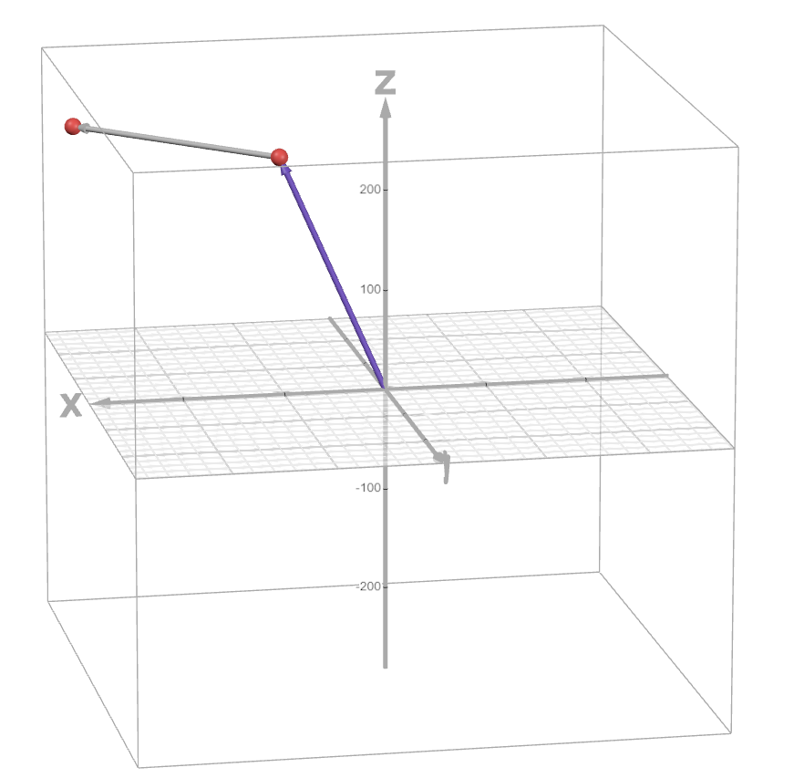
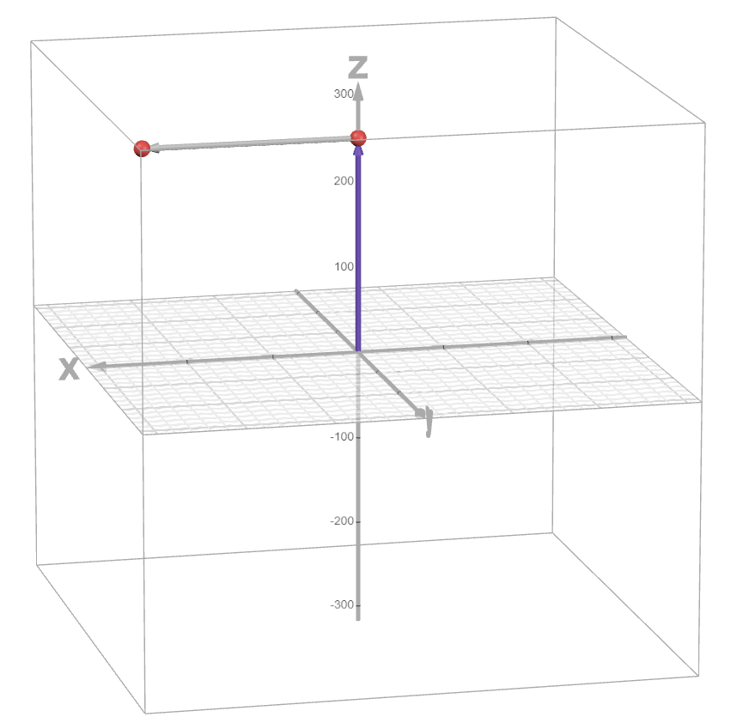
Desmos Calculator
https://www.desmos.com/3d/9bnvqc263x

